Slide 1
Lab Session
In College fest, Students want to take registrations for a Debate event and want to keep track of student details based on the department. Help the students to create a table with the help of Spring, MVC, Hibernate ORM to perform CRUD operations on the table.

Slide 2
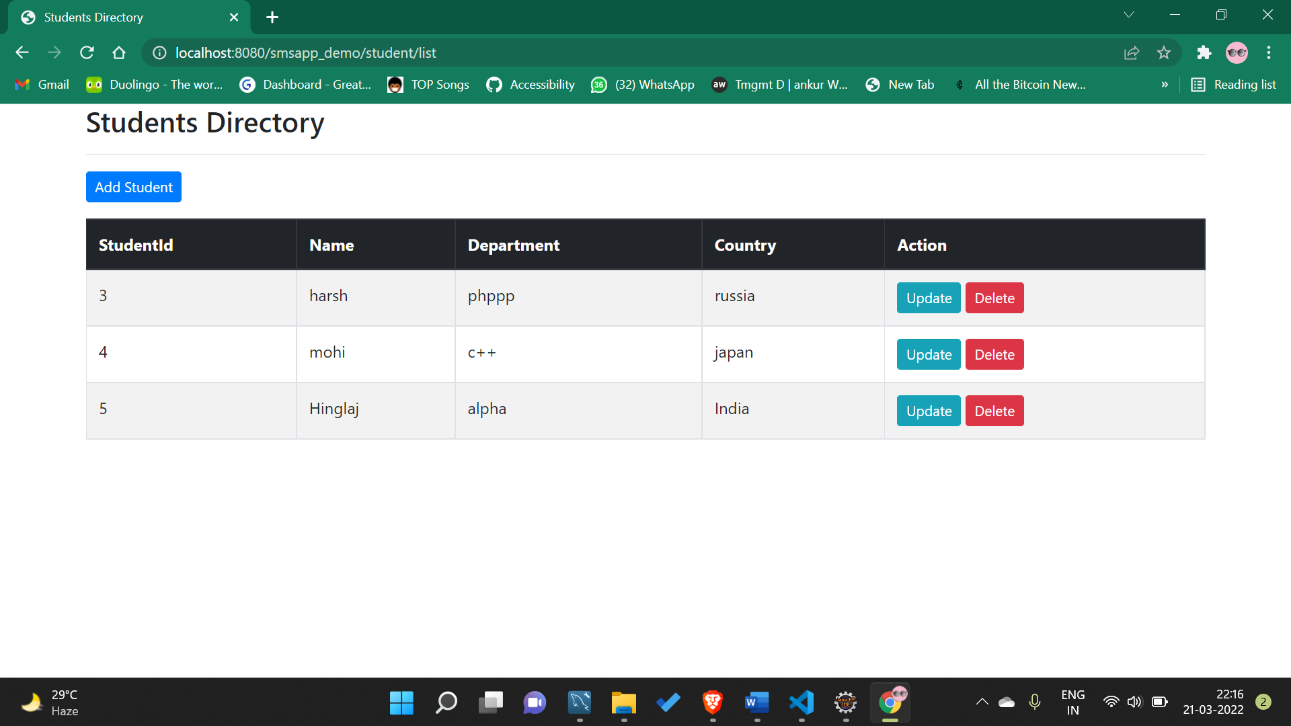
Adding New Student

Slide 3
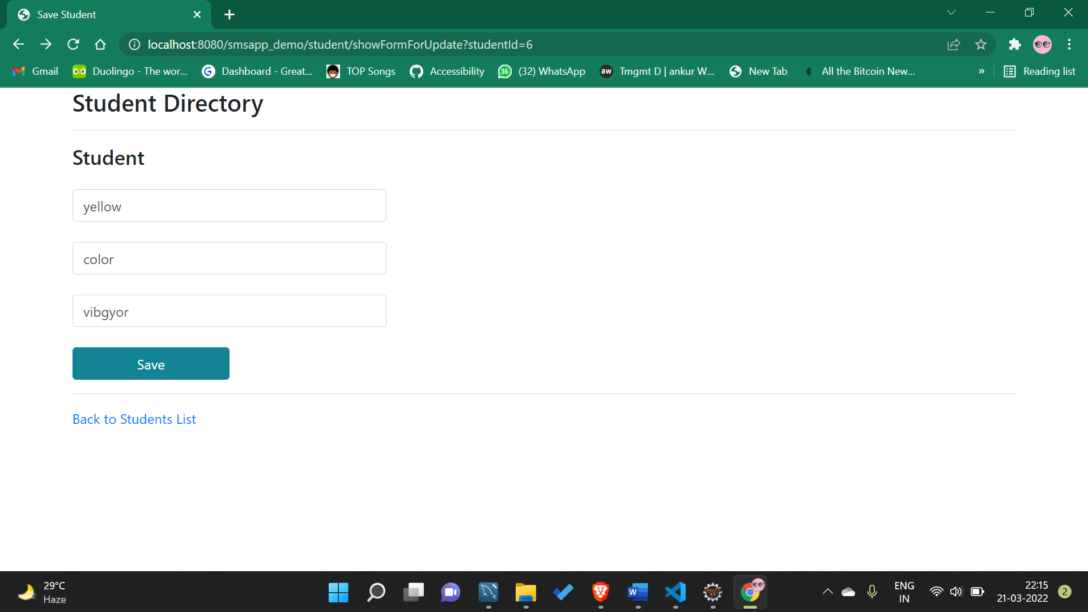

Slide 4
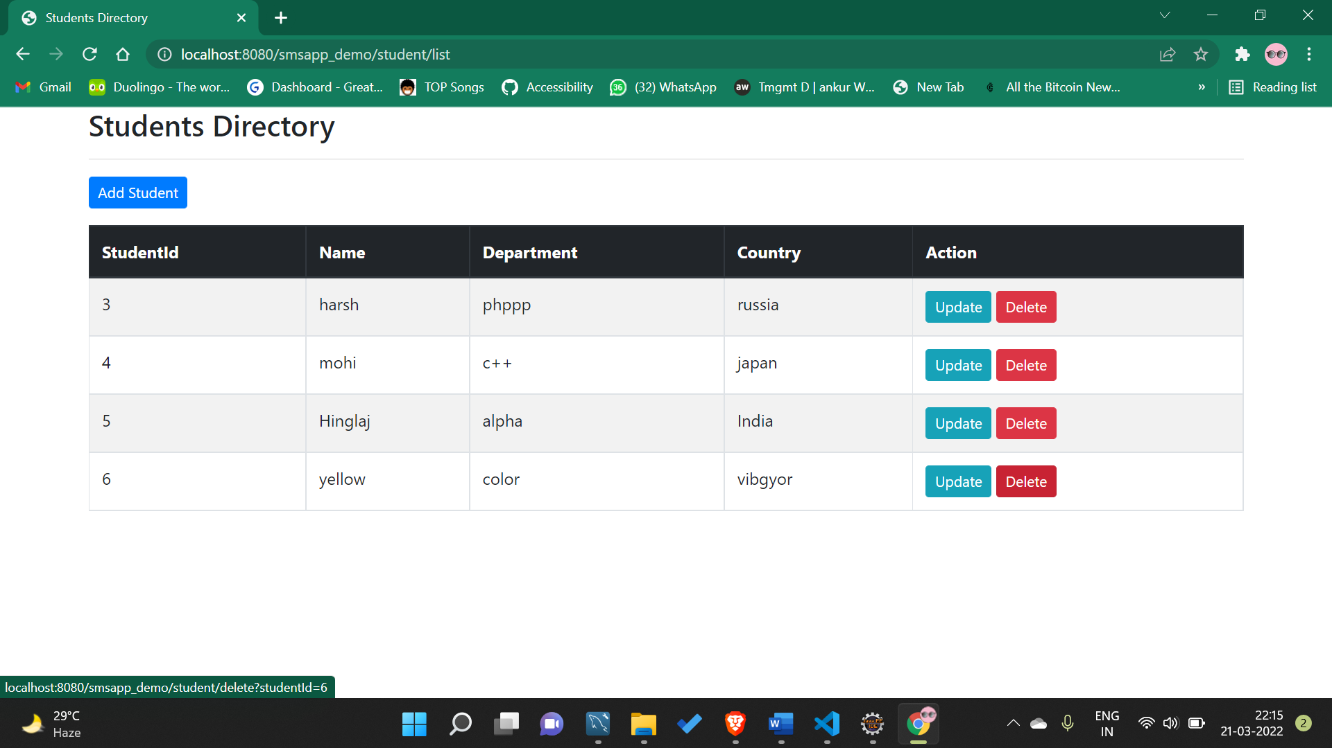
Deleting StudentId = 6

Slide 5
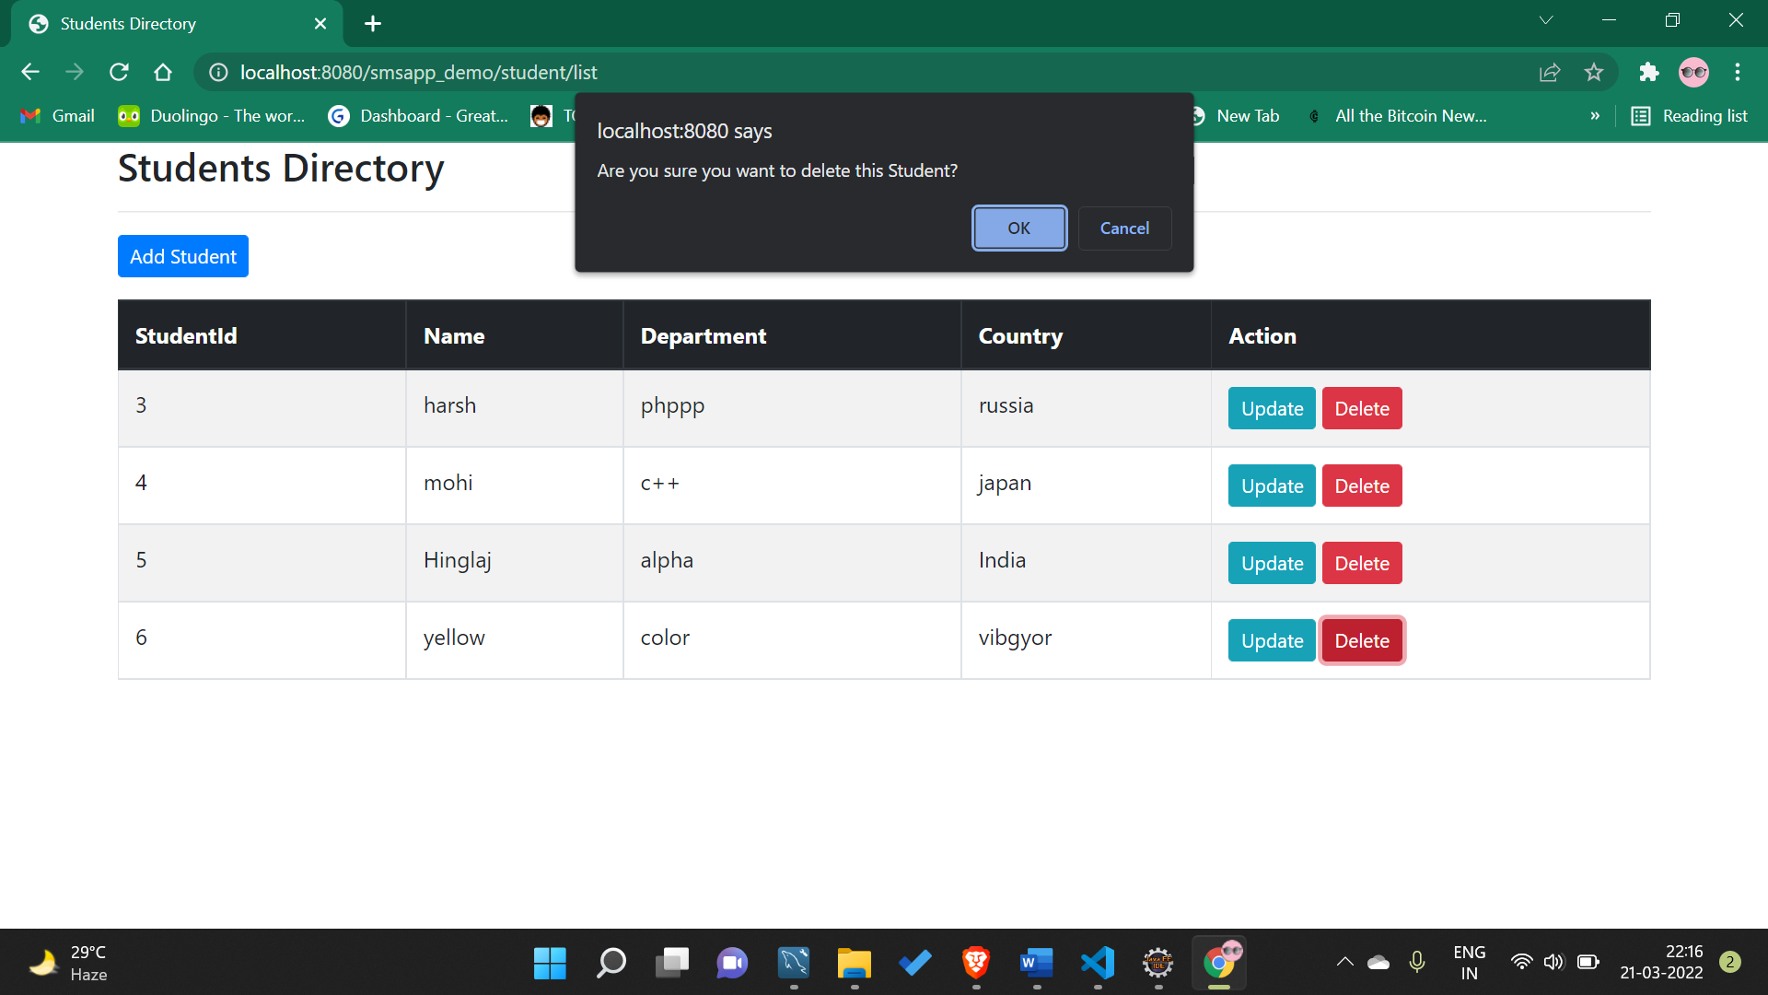

Slide 6

Before Update
After Deletion

Slide 7
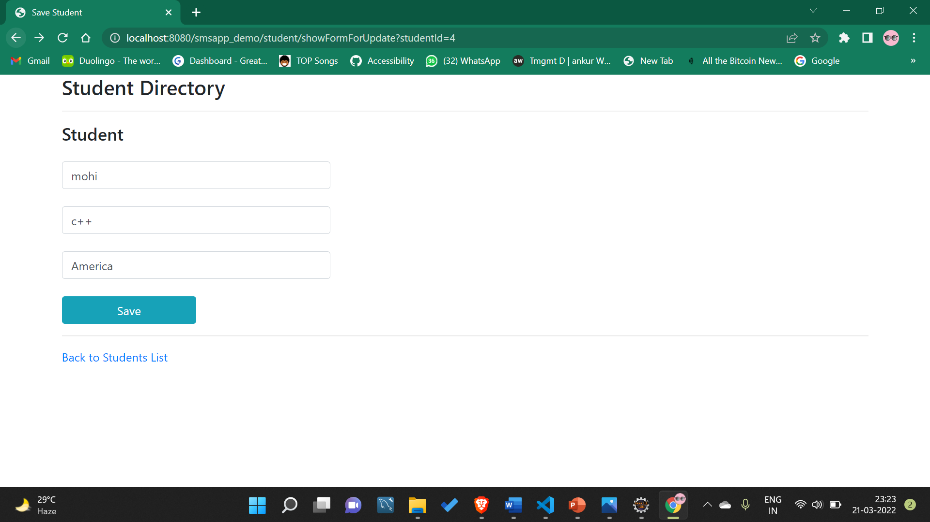

Slide 8
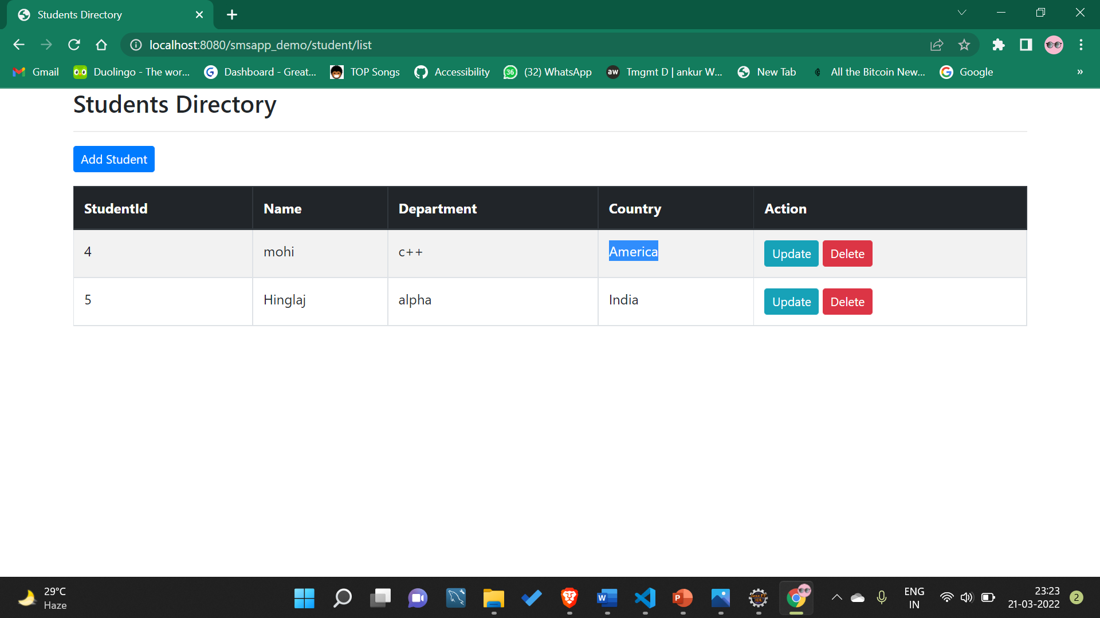
After Update

Slide 9
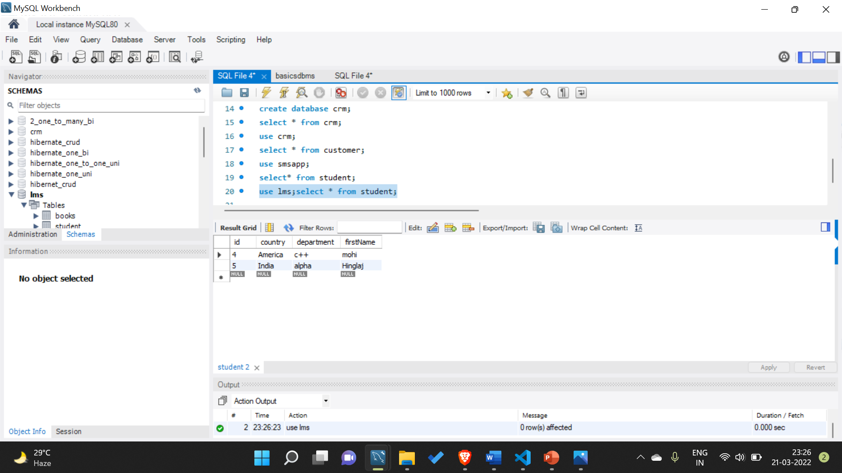
After all the CRUD operations

